Slide 1
A CASE STUDY OF WEAK BIOMETRIC ATTENDANCE AND ACCESS CONTROL SYSTEMS: HARDWARE AND SOFTWARE VULNERABILITIES IN POWER WORLD GYMS’ BIOSTAR 2 DEPLOYMENT
Members:
Balite, Dwaine Roxette E.
Jotojot, Fidel Jr. C.
Lorenzo, Eunice G.
Maraon, Rodel James G.
Palco, Nathaniel G.
September 14, 2o26

Slide 2

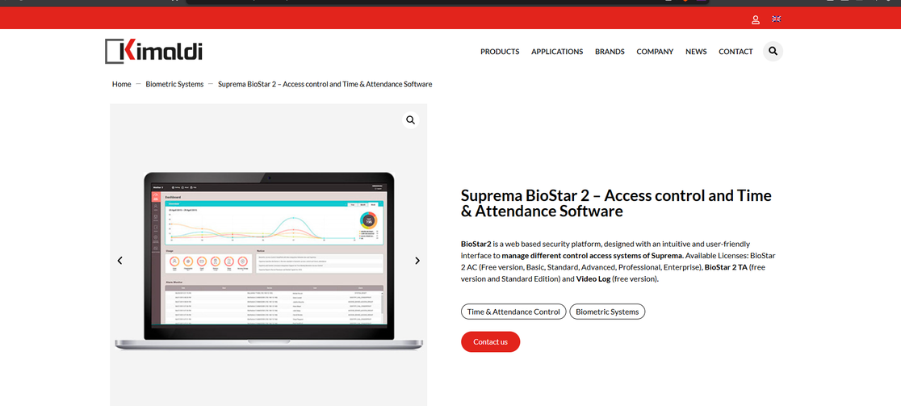
INTRODUCTION
POWER WORLD GYM
  Largest fitness center chain
  Founded: Talavou Alailima in Colombo.
  Operating over 20 facilities with more than 113,000 registered members and employees across Sri Lanka and India
  Biostar 2 - web based security platform, designed with an intuitive and user-friendly interface to manage different control access systems of Suprema.
  August 2019, Noam Rotem and Ran Locar from vpnMentor discovered a massive security incident involving Power World Gyms’ BioStar 2 database
  Exposed unencrypted binary fingerprint templates
  Facial recognition profiles
  Plain-text administrator credentials
  Employee start dates
  Security clearance levels
  Real-time timestamped entry
  Exit logs

Slide 3
IDENTIFICATION OF ASSETS
Hardware Assets:
  Biometric Terminal Scanners: Suprema BioLite 2 optical fingerprint scanners and FaceStation 2 facial recognition camera terminals installed at gym turnstiles and staff entrances.
  On-Board Terminal Controllers & Flash Memory: Embedded processing units and local storage chips on reader devices used to capture biometric signals and store device configuration parameters.
Software Assets:
  BioStar 2 Web Management Platform: The core middleware application used by administrators to manage access control policies, user roles, and system settings.
  Elasticsearch Database Engine: The database management software hosting user logs, biometric records, and system data.
  Web Application Server Interfaces: Web application endpoints and API services used for browser access and system integration.
Information Assets:
  Biometric Templates: Raw binary fingerprint feature data and facial recognition feature vectors.
  Personally Identifiable Information: User records containing full names, email addresses, phone numbers, home addresses, and employee ID numbers.
  Administrative Credentials: System administrator usernames, plain-text login passwords, and API session tokens.
  Attendance & Access Logs: Real-time timestamped check-in/check-out history tracking the movement of employees and members.
Service Assets:
  Automated Time & Attendance (T&A) Services: Automated tracking of staff working hours, shifts, and timekeeping for payroll calculation.
  Physical Access Control Services: Door unlocking and turnstile permission checks for authorized personnel and members.

Slide 4
HARDWARE VULNERABILITY ANALYSIS
Lack of On-Device Biometric Encryption: The scanner hardware processed biometric inputs without applying any irreversible cryptographic protection on the device before transmission. As a result, fingerprint and facial data left the terminals in unhashed, raw formats.
SOFTWARE VULNERABILITY ANALYSIS
Unencrypted Biometric Data Storage: The BioStar 2 database stored fingerprint and facial recognition data in plain, unencrypted formats instead of irreversible cryptographic ones, leaving biometric identity markers exposed if the database was accessed.
Unauthenticated Central Database Access: The backend database was deployed with no login authentication or password requirements and left directly reachable over the public internet, allowing anyone with the server link to view system files without any credentials.
Weak Input Validation on User Credentials: The web application lacked input validation on registration, allowing accounts with ridiculously simple passwords like "Password" and "abcd1234." Since these were stored as plain text instead of being hashed, an unauthenticated user could read them directly and use them to access accounts.
Plain-Text Administrative Credentials: The system software stored administrative account passwords and user login credentials in clear plain text rather than using secure password hashing techniques. This allowed exposed user accounts and administrative credentials to be read directly from the backend data tables.

Slide 5
CIA TRIAD ANALYSIS
Confidentiality: CRITICAL IMPACT
  Unauthorized parties accessed and extracted unencrypted user data
  Leaked: raw fingerprints, facial recognition maps, plain-text admin credentials, home addresses, emails, and entry/exit logs
  Biometric traits are permanent and cannot be reset, making the breach severe and irreversible
Integrity: CRITICAL IMPACT
  No authentication or access controls allowed unauthenticated users to modify database contents
  Attackers could alter configurations, replace biometric templates, and forge security clearance levels
  Forged biometrics bypassed physical door and turnstile controls, while audit trails could be erased to hide actions
Availability: HIGH IMPACT
  Unrestricted backend access allowed unauthorized users to run administrative database commands
  Attackers could alter, corrupt, or wipe tables holding attendance logs and user permissions
  This would cause system outages across gym locations, disrupting member access verification and staff attendance tracking

Slide 6
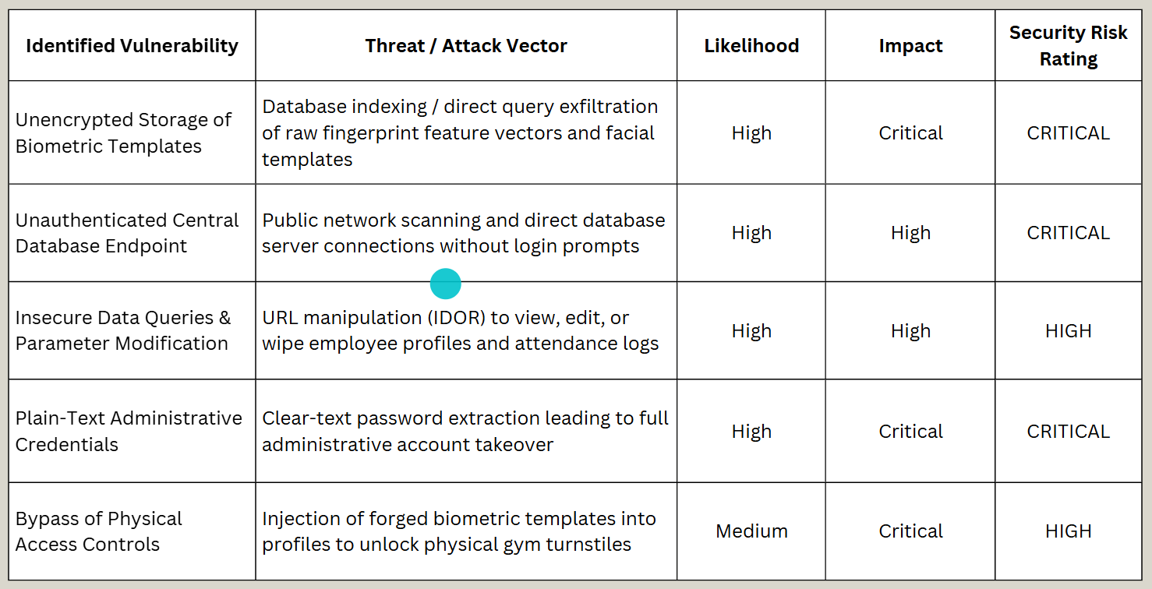
RISK ASSESSMENT

Slide 7
RECOMMENDED SECURITY CONTROLS (1)
Software Controls:
  Mandatory Database Encryption at Rest: Implement standard, strong database encryption (such as AES-256) across all storage volumes hosting biometric templates, credentials, and user profiles.
  Secure Web Application Frameworks: Re-engineer web application API endpoints to enforce strict input validation and parameterized data handling, preventing unauthorized record access or manipulation through address URL changes.
  .Cryptographic Password Protection: Enforce modern, secure password hashing methods with unique per-user cryptographic salts for all administrative and user credentials stored in software tables.
Physical Security Controls:
  Layered Physical Access Points: Pair biometric turnstiles with physical security personnel or secondary badge checks at gym entrances to verify identities during high-traffic periods.
  Physical Server & Terminal Security: Secure central hardware servers and networking equipment in locked communication closets accessible only to authorized IT staff.
Hardware Controls:
  On-Device Cryptographic Processing: Upgrade or configure scanner firmware so that terminal hardware applies non-reversible hashing algorithms directly at the sensor board before transmitting data across the network
  Hardware-Based Cryptographic Protection: Ensure biometric reader hardware incorporates dedicated secure chips to protect terminal memory and cryptographic operations from physical or logical extraction.
  Physical Tamper Protection: Deploy biometric terminals equipped with hardware chassis tamper switches that immediately wipe cached memory or alert administrators if reader enclosures are physically opened
Notes:
On-Device Cryptographic Processing
Meaning:
Protect the biometric data inside the scanner before sending it to the server.
Example:
A fingerprint is scanned → the scanner converts it into a protected mathematical representation → only that protected data is sent to the server.
Why:
If someone intercepts the data, they don't get the original fingerprint information. This addresses the paper's concern about raw biometric data leaving the scanner.
Hardware-Based Cryptographic Protection
Meaning:
Use secure chips or protected hardware inside the biometric device to protect sensitive data and encryption operations.
Example:
If someone physically takes apart a fingerprint scanner, they should not be able to simply remove a chip and retrieve stored biometric information or encryption keys.
Why:
It protects the device against physical or logical extraction of sensitive information.
Physical Tamper Protection
Meaning:
The scanner should detect when someone physically opens or tampers with it.
Example:
Someone opens the scanner casing → the device detects the tampering → stored sensitive information is erased or an alert is sent to the administrator.
Why:
It adds protection against someone physically attacking the biometric terminal.
Mandatory Database Encryption at Rest
Meaning:
Encrypt sensitive information while it is stored in the database.
Example:
Instead of storing:
John Doe – Fingerprint Data – Password
the database stores the information in encrypted form that cannot simply be read.
Why:
If an attacker steals the database, the information is still protected. The paper specifically recommends strong encryption such as AES-256.
Secure Web Application Frameworks
Meaning:
The application must check whether a user is actually allowed to access or modify the requested information.
Example:
An employee can access:
User ID 100
They change the URL to:
User ID 101
The system should reject the request instead of showing User 101's information.
Why:
This prevents unauthorized access through URL or parameter manipulation, which was one of the weaknesses identified in the BioStar 2 system.
Cryptographic Password Protection
Meaning:
Never store passwords as plain text. Store them using secure password hashing with unique salts.
Example:
Instead of the database containing:
Admin → password123
it stores a password hash that cannot simply be read as the original password.
Why:
If the database is compromised, attackers shouldn't immediately see everyone's passwords. This directly addresses the paper's finding that administrative credentials were stored in plain text.
Layered Physical Access Points
Meaning:
Don't rely on the biometric scanner as the only security check.
Example:
Instead of:
Fingerprint → Door opens
use:
Fingerprint → Badge/security verification → Door opens
A security guard could also verify suspicious or unusual access attempts.
Why:
If the biometric system is compromised, another security layer can still prevent unauthorized entry.
Physical Server & Terminal Security
Meaning:
Keep important servers and networking equipment in secure areas.
Example:
The BioStar server is placed inside a locked server room. Only authorized IT staff have access.
Why:
Someone who can physically access the server or network equipment could potentially tamper with or steal it.

Slide 8
RECOMMENDED SECURITY CONTROLS (2)
PREVENTION STRATEGY (1)
Logical Security Controls:
  Database Network Isolation: Restrict central database ports behind strict network firewalls, preventing direct public internet reachability.
  Network Segmentation: Isolate physical biometric reader hardware on dedicated, separate virtual local area networks (VLANs) isolated from general gym administrative networks.
  Role-Based Access Control (RBAC): Enforce strict least-privilege permissions within software dashboards to ensure user roles can only view or modify their necessary system resources.
Administrative Controls:
  Multi-Factor Authentication (MFA): Require mandatory multi-factor authentication for all administrative accounts accessing the system dashboard.
  Routine Security Audits & Vulnerability Testing: Mandate periodic third-party security reviews, penetration testing, and software configuration checks prior to system updates.
  Vendor Risk Assessment Policies: Establish formal vendor evaluation standards to verify that third-party hardware and software platforms meet data protection regulations before system deployment.
Prevention Through Secure Hardware Implementation:
  Edge-Based Cryptographic Protection: Implementing scanner hardware that applies non-reversible hashing at the device level would have prevented raw biometric templates from existing in readable formats. Even if a database compromise occurred, intercepted payloads would have yielded useless mathematical representations instead of raw fingerprint and facial data.
  Hardware-Based Storage & Integrity Protections: Deploying biometric reader hardware equipped with dedicated secure memory components would have ensured that terminal configuration keys, device firmware, and transmitted payloads were cryptographically protected from physical tampering or unauthorized extraction.
  Encrypted Endpoint Channels: Enforcing encrypted end-to-end communication channels directly from physical reader hardware to the server backend would have prevented traffic sniffing or unauthorized data manipulation across local networks.
Notes:
Database Network Isolation
Meaning:
The database should not be directly reachable from the public internet.
Example:
❌ Bad:
Internet → Database
✅ Better:
Internet → Firewall → Application → Database
The firewall only allows authorized systems to communicate with the database.
Why:
This directly prevents the kind of public exposure that occurred in the BioStar 2 incident.
Network Segmentation
Meaning:
Separate important devices into different networks/VLANs.
Example:
VLAN 10 → Office computers
VLAN 20 → Guest Wi-Fi
VLAN 30 → Biometric scanners
VLAN 40 → Servers
An office computer shouldn't automatically be able to communicate directly with the biometric server.
Why:
If one network is compromised, segmentation limits the attacker's ability to move to other systems. The paper specifically recommends isolating biometric readers on dedicated VLANs.
Role-Based Access Control (RBAC)
Meaning:
Give users only the permissions they need for their job.
Example:
Role Permission
Security Guard View access logs
Manager Manage users
IT Administrator Configure system
Regular Employee Access own attendance
A security guard shouldn't be able to modify everyone's biometric information.
Why:
It follows the principle of least privilege, reducing the damage that can happen if an account is compromised.
Multi-Factor Authentication (MFA)
Meaning:
Require more than just a password when an administrator logs in.
Example:
Username + Password + Authentication Code
So even if an attacker steals the administrator's password, they still need the second factor.
Why:
It provides another layer of protection for highly privileged accounts.
Routine Security Audits & Vulnerability Testing
Meaning:
Regularly check the system for security weaknesses before attackers find them.
Example:
A company hires security professionals to perform a penetration test and discovers:
"Your database can be accessed from the internet without authentication."
The organization can fix it before a real attacker exploits it.
Why:
The paper recommends third-party security reviews, penetration testing, and configuration checks.
Vendor Risk Assessment
Meaning:
Check the security of a third-party company/product before using it.
Example:
Before deploying a biometric system, Power World Gyms could ask:
"Does the system encrypt biometric data?"
"Are passwords securely stored?"
"Can the database be accessed from the internet?"
"How does the vendor handle vulnerabilities?"
Why:
Organizations are also responsible for risks introduced by the hardware and software they purchase from vendors.
Edge based crytographic - "hash at sensor not at the server", Normally, a fingerprint or face scan gets converted into a "template" and if it was stored or transmitted in plain, reversible form, anyone who steals it has effectively stolen the person's fingerprint. By building the hashing (a one-way cryptographic transform) directly into the scanner hardware, the raw template never leaves the device unprotected — only an irreversible hash travels downstream.
Hardware-Based Storage & Integrity Protections
This refers to things like a Trusted Platform Module (TPM) or Secure Enclave embedded in the reader itself. These are tamper-resistant chips that store cryptographic keys and firmware in a way that's extremely difficult to physically extract, even if someone has the device in their hands. Without this, an attacker with physical access could potentially desolder chips, dump firmware, or extract configuration keys used to authenticate the device to the backend — allowing spoofed devices or manipulated data.
Encrypted Endpoint Channels refers to the two ends of that connection — the scanner (one endpoint) and the server (the other endpoint) — and "encrypted channel" means the data is locked up for that entire journey between those two points, not that the journey itself changes. It's still going through the local network. It's just unreadable and tamper-evident while it does.

Slide 9
PREVENTION STRATEGY (2)
Prevention Through Secure Software Development Lifecycle (SSDLC):
  Secure Architecture & Threat Modeling (Design Phase): During the initial architectural design phase, threat modeling would have identified the high risk of storing unencrypted biometric data and exposing database ports to public networks. Designing the system under the principle of "Security by Design" would have mandated default database authentication and AES-256 encryption at rest for all sensitive data.
  Automated & Manual Security Code Reviews (Development Phase): Incorporating static and dynamic software testing tools into the development process would have automatically flagged plain-text password storage, unhashed biometric variables, and improper URL parameter handling prior to software deployment.
  Strict Parameterized Queries & Access Controls (Coding Standards): Adhering to secure coding guidelines would have ensured that all web application endpoints enforced server-side permission checks and sanitized input parameters, preventing authorization bypasses via address bar manipulation.
  Comprehensive Pre-Deployment Vulnerability Audits (Testing Phase): Conducting mandatory third-party security audits and penetration testing before releasing production updates would have exposed the unauthenticated Elasticsearch database port and missing login prompts, allowing developers to apply firewall rules and access control lists prior to public deployment.
Notes:
AES-256 encryption at rest
"At rest" is the key phrase — it means data while it's sitting in storage, on a hard drive, not while it's moving across a network.
AES-256 is a specific, very strong, industry-standard encryption algorithm. So this means: even if someone bypasses every other defense and gets direct access to the actual database files sitting on disk, what they find isn't your biometric templates in plain readable form — it's ciphertext, scrambled by AES-256, unreadable without the correct decryption key. Similar in spirit to hashing (which we discussed earlier) but not identical — encryption is reversible if you have the key, whereas hashing is designed to be irreversible even with a key.
Automated & Manual Security Code Reviews (Development Phase)
-Static Application Security Testing (SAST) scans source code without running it, looking for patterns like hardcoded credentials, plaintext password fields, or missing encryption calls.
-Dynamic Application Security Testing (DAST) tests the running application, sending malicious inputs to see how it behaves.
Together, these would catch things like unhashed biometric variables sitting in code, or URL parameters that pass sensitive data without sanitization — before the code ever reaches production.
Strict Parameterized Queries & Access Controls (Coding Standards)
- Parameterized queries prevent SQL/NoSQL injection by treating user input strictly as data, never as executable query logic. The "address bar manipulation" mentioned refers to Insecure Direct Object Reference — e.g., changing ?user_id=1002 to ?user_id=1003 in a URL to view someone else's data. Proper server-side authorization checks (verifying the logged-in user actually owns or has rights to the requested resource, not just checking that they're logged in at all) close this gap.
Elastucsearch is a popular database/search engine technology. It's specifically designed to store large amounts of data and let you search through it extremely fast

Slide 10
CONCLUSION
The 2019 Power World Gyms data breach shows what happens when both hardware and software security fail at the same time. The physical scanners captured raw fingerprints and face scans without scrambling the data first. At the same time, the backend system stored that sensitive information without encryption, left the database open to the public internet without a password, saved admin login details in plain text, and allowed users to alter profiles just by tweaking website link addresses.
Because biological traits like fingerprints and facial features cannot be changed like regular digital passwords, losing this information permanently exposes the private identities of thousands of users. Ultimately, this case proves that real security requires safety at every step—from the physical scanner on the wall to the server hosting the database.
Notes:
2019 Suprema BioStar 2 data breach at Power World Gyms
the failure started - hardware.
compounded - software.
So the real lesson here is: security isn't just one lock on one door. It's the scanner, the database, the passwords, and the website code all needing to hold up together. This case is basically what happens when literally every one of those layers fails at the same time.

Slide 11
REFERENCES
  Rotem, N., & Locar, R. (2019, August 14). Report: Major Breach Found in BioStar 2 Database. vpnMentor Research Lab. https://www.vpnmentor.com/blog/report-biostar2-leak/
  CEM Systems & Suprema Inc. (2018). Suprema BioStar 2 Integrated Security Platform Technical Specification Datasheet. AeroExpo / CEM Systems Documentation. https://pdf.aeroexpo.online/pdf/cem-systems/suprema-biostar-2/172460-29410.html
  Infosecurity Magazine. (2019, August 14). Millions of Records Exposed in Biometric Database. Reed Exhibitions / Infosecurity Group. https://www.infosecurity-magazine.com/news/millions-of-records-exposed/
  Adhikari, R. (2019, August 15). 28M Records Exposed in Biometric Security Data Breach. TechNewsWorld / ECT News Network. https://www.technewsworld.com/story/28m-records-exposed-in-biometric-security-data-breach-86186.html
  Endeavor Business Media. (2019, August 22). Report: Biometric Data Exposed in Suprema BioStar 2 Breach. Endeavor Business Media. https://www.securityinfowatch.com/access-identity/biometrics/news/21093873/report-biometric-data-exposed-in-suprema-biostar-2-breach
  Burt, C. (2019, August 15). Millions of Unencrypted Biometric Fingerprint and Face Records Exposed to Web; Suprema Responds. Biometric Update / Iristech. https://www.biometricupdate.com/201908/millions-of-unencrypted-biometric-fingerprint-and-face-records-exposed-to-web-suprema-responds
  Tech Monitor (2019, August 14). White Hats Hack BioStar 2 Biometrics Database, Expose 27.8M Records. Tech Monitor / NS Media Group. https://www.techmonitor.ai/technology/cybersecurity/biostar-2-vpnmentor
  Orr, J. (2019, August 16). Incident of the week: Passwords and biometrics info for one million users exposed in BioStar 2 data breach. Cyber Security Hub. https://www.cshub.com/attacks/articles/incident-of-the-week-passwords-and-biometrics-info-for-one-million-users-exposed-in-biostar-2-data-breach

